Slide 1
Corn Demand Index: Charts and Insights

Slide 2
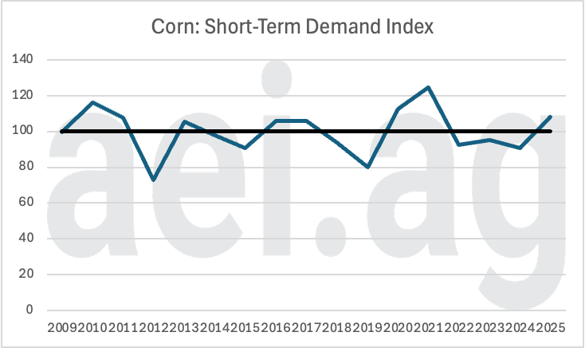
Short Term Corn Demand
In 2025, the corn market is enjoying a positive demand shock
2025 is the first positive short-term demand shock in 3 year
While positive, the short-term index is not as high as it was in 2020-2021
Note:
This will be measure and reported monthly

Slide 3
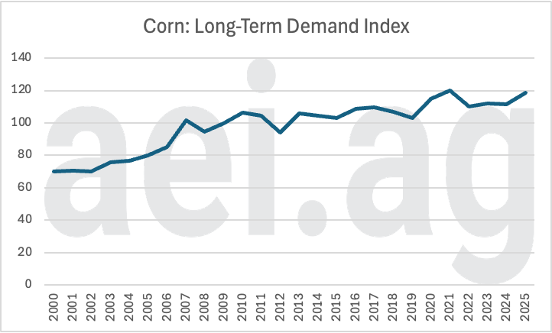
Long Term Corn Demand
Corn demand, in total, is approaching record highs
Corn demand trend upward overtime, but not linearly (stairsteps)
There have been three paradigms:
2000 to 2005
2010 to 2019
2020 to 2025
Note: This will be measure and reported monthly

Slide 4
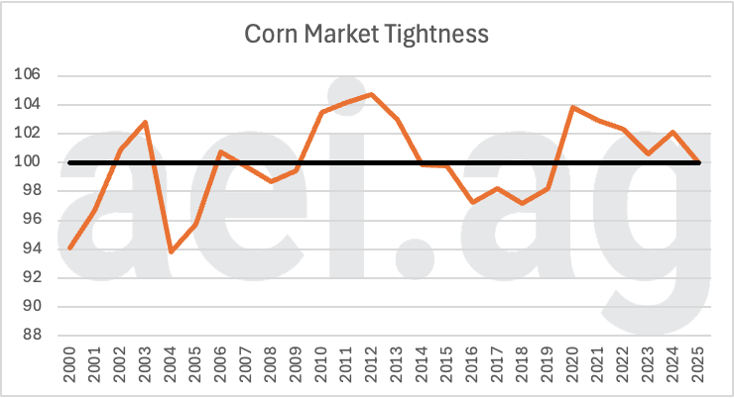
Corn Market Tightness Index
Usage is strong, but abundant supplies have weighed on market.
In 2025, corn tightness index fell to the lowest levels since 2020.
Two implications:
The markets since 2020 have benefited from tighter-than-normals markets (usage relative to supplies)
Fewer corn acres in 2026 could increase tightness in 2026, especially if demand (and usage) remain strong
Note: This will be measure and reported monthly

Slide 5
Sketch of web tool

Slide 6
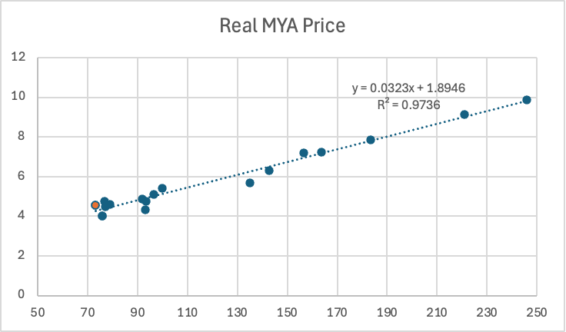
Corn Price Estimate
Demand Scenarios
Sources of Change
Projected Supply:
18.3
Billion bushels
Estimated Price: $4.16
Projected Usage:
16.3
Billion bushels

Slide 7
Corn Price Estimate
Demand Scenarios
Sources of Change
Projected Supply:
18.3
Billion bushels
Estimated Price: $4.02
(Short-term demand index @ 100)
Corn Prices at Alternative Demand Scenarios
Average Price
Range
Probability
Low Demand
$3.72
$3.41 - $3.86
41%
Med. Demand
$4.18
$3.96 - $4.32
35%
High Demand
$4.66
$4.35 - $5.09
24%

Slide 8
Corn Price Estimate
Demand Scenarios
Sources of Change
2024 to 2025
2025
Higher Supplies: -$1.16
Month | From Supply | From Demand
June | -$X.XX | +$0.XX
July | -$X.XX | +$0.XX
Aug. | -$X.XX | +$0.XX
Sept. | -$X.XX | +$0.XX
Oct. | -$X.XX | +$0.XX
Nov. | -$X.XX | +$0.XX
Dec. | -$X.XX | +$0.XX
Higher Demand: +0.32

Slide 9
Research Details

Slide 10
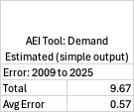

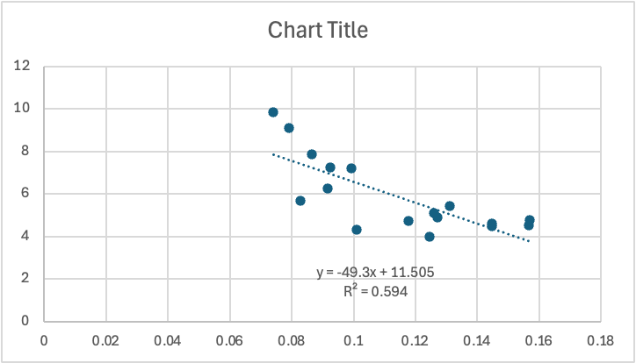
Better Insights, A Better Tool
Ending Stocks
Corn Demand Project

